Slide 1
JavaScript - a Brief Introduction

Slide 2
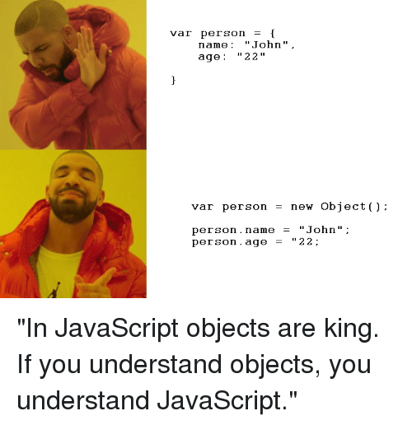
What is JavaScript
Object based (not object oriented) programming language
very limited object creation
a set of pre-defined objects associated with
HTML document structure
many HTML tags constitute JS Objects
Browser functionality
provides a limited API to Browser functionality

Slide 3
It is first implemented by Netscape (with help from Sun Microsystems). JavaScript was created by Brendan Eich at Netscape in 1995 for the purpose of allowing code in web-pages (performing logical operation on client side).

Slide 4


Slide 5
It is not compiled but translated. JavaScript Translator is responsible to translate the JavaScript code which is embedded in browser.

Slide 6
Netscape first introduced a JavaScript interpreter in Navigator 2. The interpreter was an extra software component in the browser that was capable of interpreting JavaScript source code inside an HTML document. This means that web page developer no need other software other than a text editor of develop any web page.

Slide 7
Why we Use JavaScript?
Using HTML we can only design a web page but you can not run any logic on web browser like addition of two numbers, check any condition, looping statements (for, while), decision making statement (if-else) at client side. All these are not possible using HTML So for perform all these task at client side you need to use JavaScript.

Slide 8
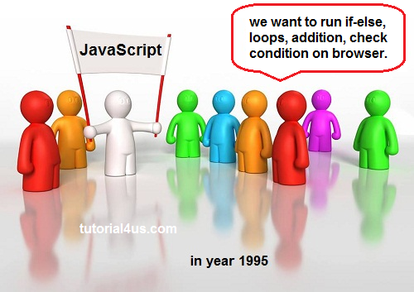

Slide 9
JavaScript…Java ?
Java - Programming Language (PL)
Interactive Web Graphics
Creating web browser applications
Writing stand-alone applications
JavaScript - Scripting Language
Runs within the context of the Web browser
Customizing pages based on browser version
Visual Feedback to user actions
Validating data entered on HTML Forms

Slide 10
What can it be used for
Some pretty amazing things….
Text animation
graphic animation
simple browser based application
HTML forms submission
client-side forms data validation (relieving the server of this task)
web site navigation

Slide 11
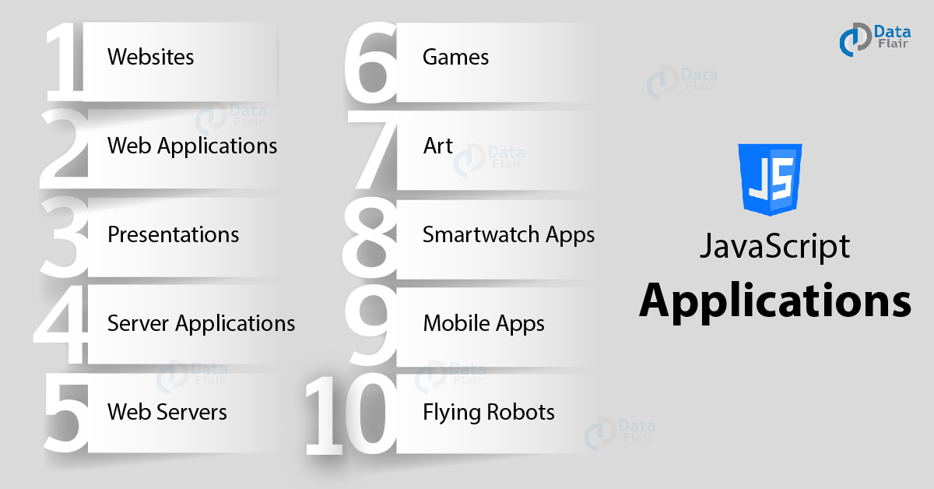
Applications of Javascripts

Slide 12
10 THINGS YOU CAN BUILD WITH JAVASCRIPT
1. WEBSITES:
Okay, so you can file this one under ‘pretty obvious’. Adding interactivity and behavior to otherwise static sites was what JavaScript was invented to do by Brendan Eich way back in 1995. It’s still used for that. This one’s easy. Any remotely modern web site is running JavaScript on some level.
See for yourself https://www.creativebloq.com/web-design/examples-of-javascript-1233964

Slide 13
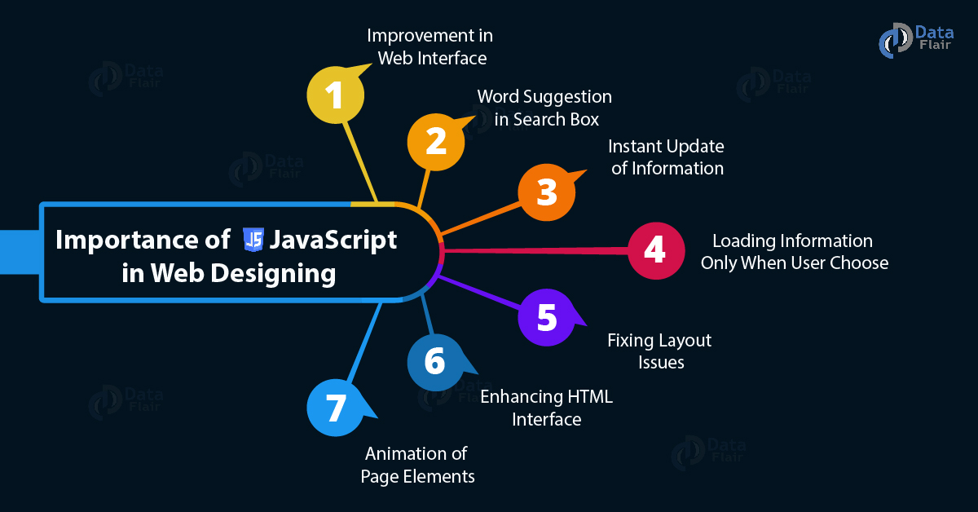

Slide 14
10 THINGS YOU CAN BUILD WITH JAVASCRIPT
2. WEB APPLICATIONS:
As browsers and personal computers have continued to improve, so, too, has the abilities to create robust web applications. Just think of applications like Google Maps. If you want to explore a map in Google Maps, all you have to do is click and drag with the mouse. You may see a part of the map that is less detailed that then fills itself in. That’s JavaScript at work behind the scenes.

Slide 15
10 THINGS YOU CAN BUILD WITH JAVASCRIPT
3. PRESENTATIONS:
A very popular use for JavaScript is to create presentations as websites. Who needs Powerpoint or Keynote? Using the RevealJS library this becomes really easy if you’re already familiar with HTML and CSS. If you’re not familiar with these tools, you can still use slides.com, which uses RevealJS to build a web-based slide deck for you.

Slide 16
10 THINGS YOU CAN BUILD WITH JAVASCRIPT
4. SERVER APPLICATIONS:
With the advent of NodeJS a few year ago, JavaScript made its way from the browser and into the server. Since then, Node has been adopted by many major companies, such as Wal-Mart, as a key part of their back-end infrastructure.

Slide 17
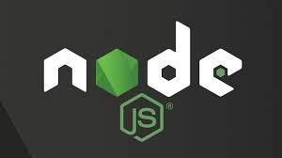
Node.js® is a JavaScript runtime built on Chrome's V8 JavaScript engine.
As an asynchronous event-driven JavaScript runtime, Node.js is designed to build scalable network applications. many connections can be handled concurrently.

Slide 18
10 THINGS YOU CAN BUILD WITH JAVASCRIPT
5. WEB SERVERS:
While we’re on the topic of server applications. Have you seen Node’s Hello World application? It’s easy to build a web server in about 10 lines of code. Of course, you can create much more robust servers using node or the standard server application framework expressJS. Many of the previously mentioned applications using Node are actually built using the MEAN stack (Mongo, Express, Angular, Node), of which Express is a key component.

Slide 19
10 THINGS YOU CAN BUILD WITH JAVASCRIPT
6. GAMES:
While the browser hasn’t been a traditional games platform in the past, recently it has become a robust venue for games. Additionally, with the addition of the HTML5 canvas (more on that in a second), the level of complexity that is possible in browser-based games has increased exponentially. There are even browser games to teach you programming!
See for yourself https://tutorialzine.com/2019/02/10-amazing-javascript-games

Slide 20
10 THINGS YOU CAN BUILD WITH JAVASCRIPT
7. ART:
One of the new features in the HTML5 specification is the canvas element,which allows the browser to render three-dimensional shapes. This opened the browser as a new medium for digital art projects.

Slide 21
10 THINGS YOU CAN BUILD WITH JAVASCRIPT
8. SMARTWATCH APPS:
Popular smartwatch maker Pebble has created Pebble.js, a small javascript framework that allows a developer to create an application for the Pebble line of watches in JavaScript. But Pebble makes up a relatively small part of the market share. What if you want to develop for iOS or Android…

Slide 22
10 THINGS YOU CAN BUILD WITH JAVASCRIPT
9. MOBILE APPS:
One of the most powerful things you can do with JavaScript is build applications for non-web contexts. That’s a fancy way of saying you can make apps for things that aren’t the internet. For instance, mobile devices are now the most popular way to access the internet. What this means is that ALL of your websites should be responsive (but that could be another blog post). Additionally, it means that mobile applications are as important a product as a web property for digital goods. The catch is that mobile apps come in two major flavors, Apple and Android. And those apps are written in two completely different languages. So that means you need three times as many developers to build and support a product for mobile devices plus the web. Here’s the good news: It is possible to have a ‘write it once’ solution for all three platforms. Phonegap is one of the oldest and well-established frameworks in this space.

Slide 23

More recently React Native has come on the scene and shows a lot of promise of becoming the major player in the cross-platform space.
React native is an open source framework created and maintained by facebook. It is one of the other popular cross-platform frameworks that have been launched by social media king Facebook
Long story short: You can make mobile apps with JavaScript you can deploy and download right to their respective app stores. Here’s a list of apps made with React Native.

Slide 24
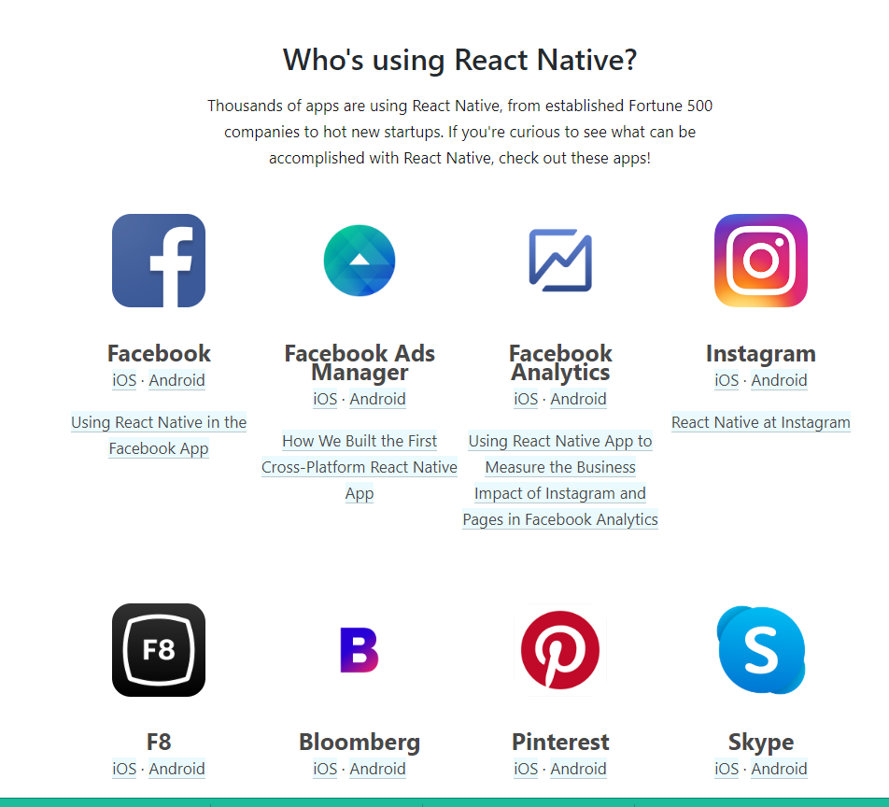

Slide 25
10 THINGS YOU CAN BUILD WITH JAVASCRIPT
10. FLYING ROBOTS:
Yes, you read that right. Several commercially available quadcopters come outfitted with a simple OS that makes it possible to install NodeJS. This means that you can program a flying robot using JavaScript. As it’s probably pretty clear, Atwood’s Law continues to ring true but not in a bad way. JavaScript remains the most accessible programming language on the planet. So it’s great to see that it’s possible to create such a wide variety of projects using it.

Slide 26
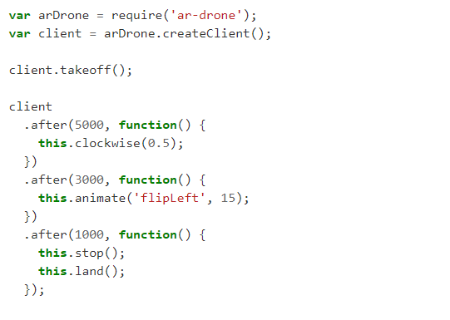
Programming a drone is easy!
Install Node.js and get the ar-drone module. All you need to do then is to execute the following code with node.
That will make your drone take off, move around, do a flip and carefully land again. Seriously, that’s all!

